Slide 1
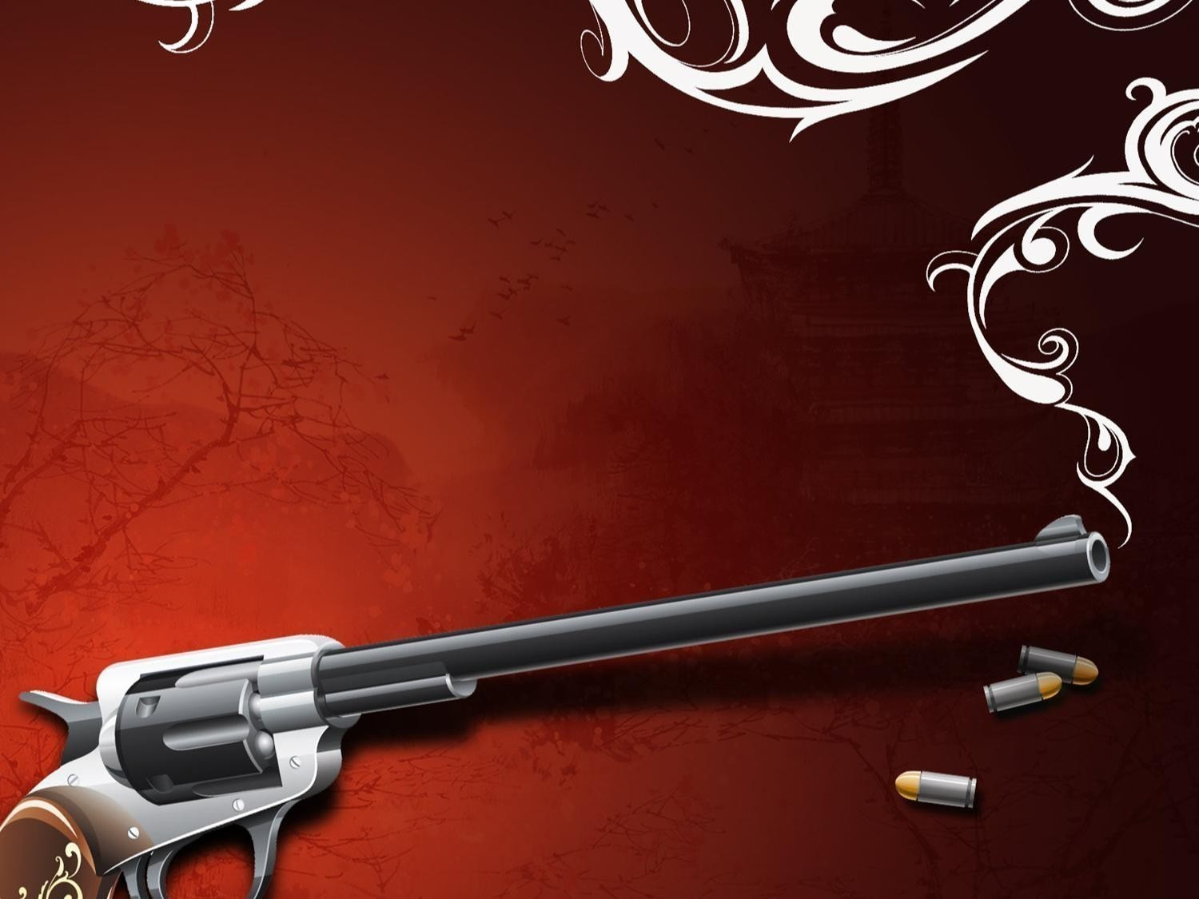
How They
Throw Out a Challenge
5656656

Slide 2
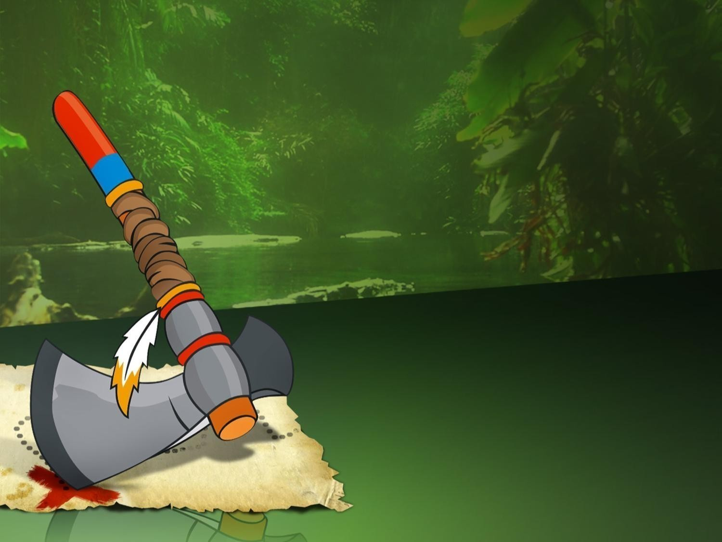
Native Americans (XVII century)
put a tomahawk
on the ground in the rival’s camp

Slide 3
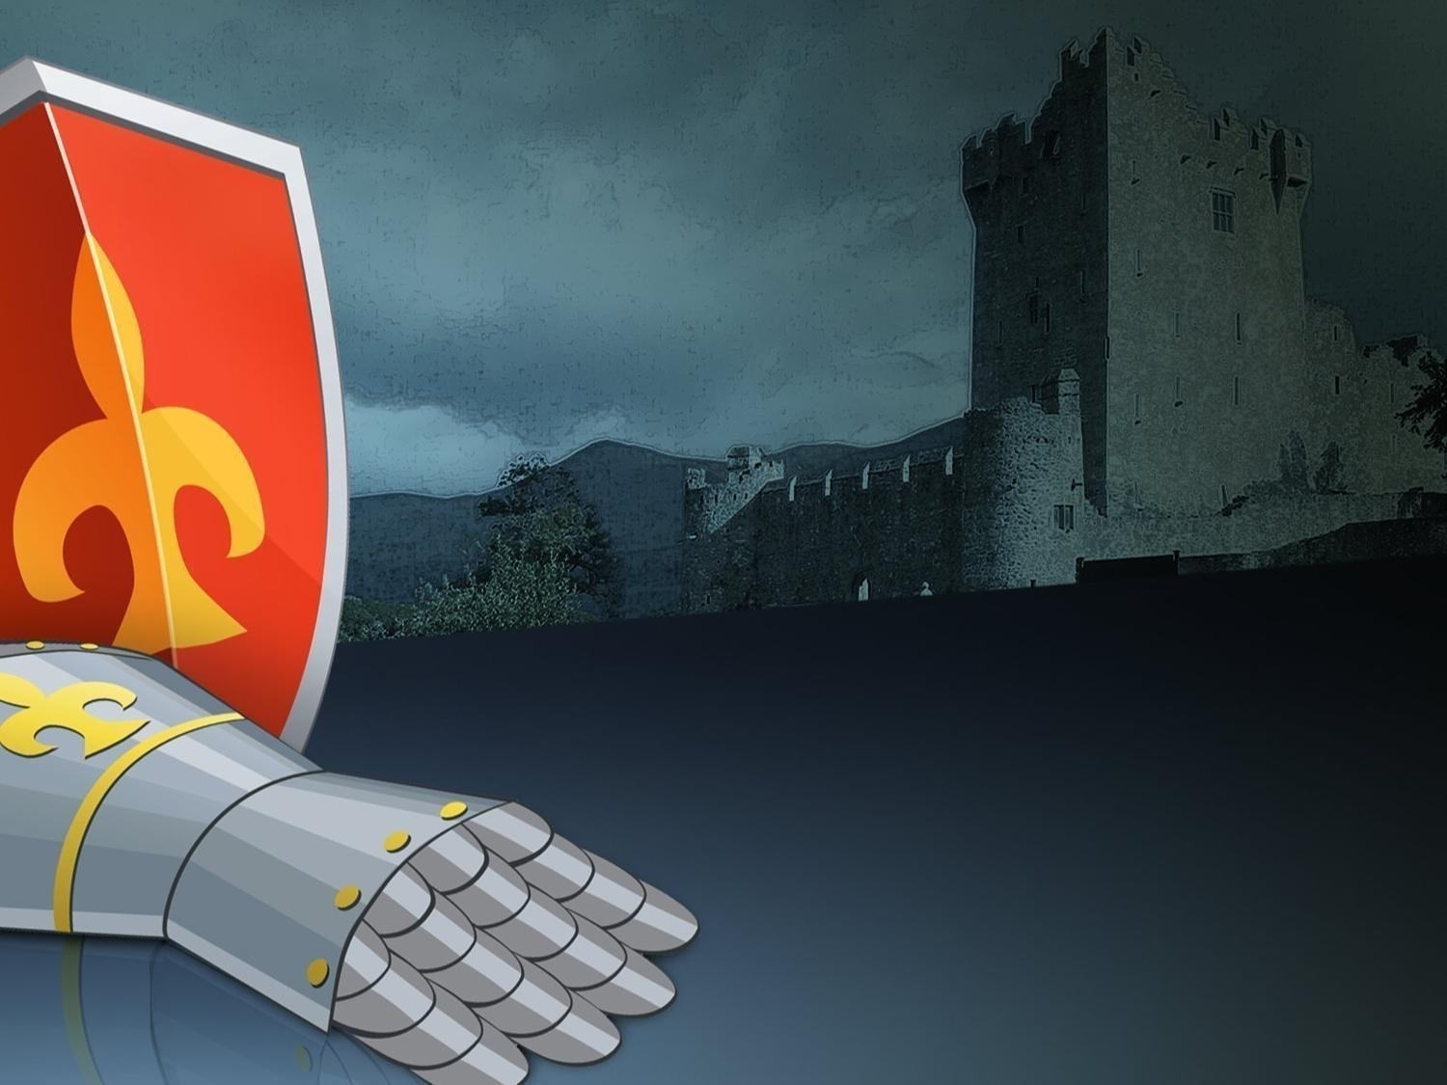
European Knights
(XII-XVI centuries)
threw a glove
in the rival’s face

Slide 4
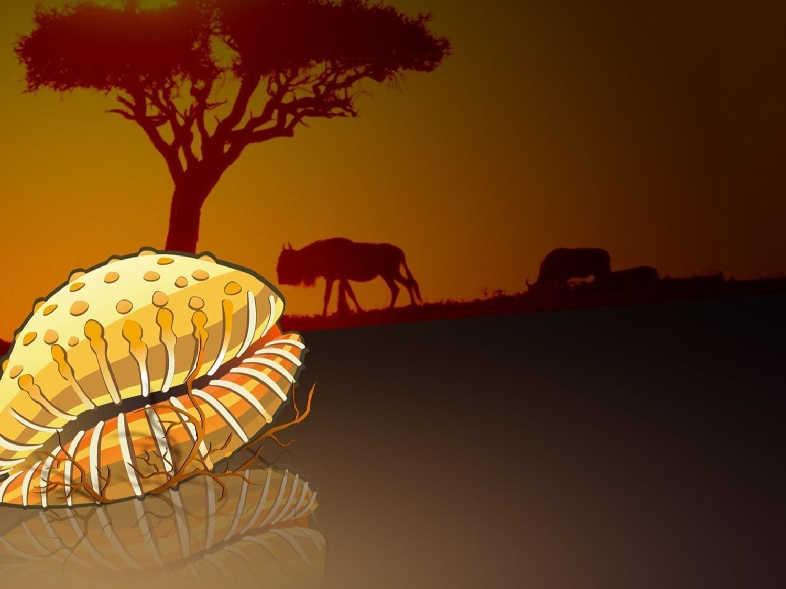
African Yoruba tribes
sent a single
Cypraea shell
to the rivals

Slide 5
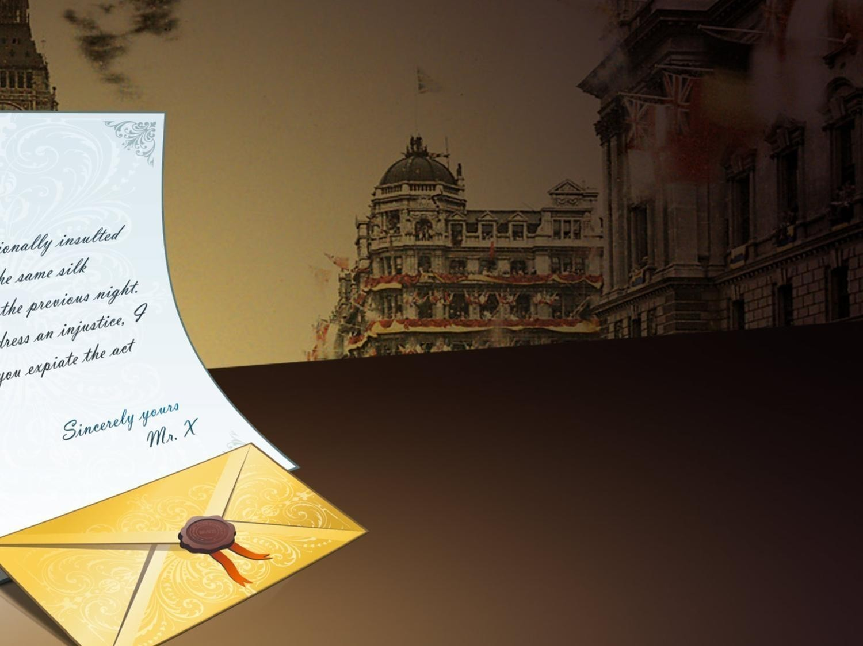
English gentlemen
(XVII century)
sent a polite note
with the challenge

Slide 6
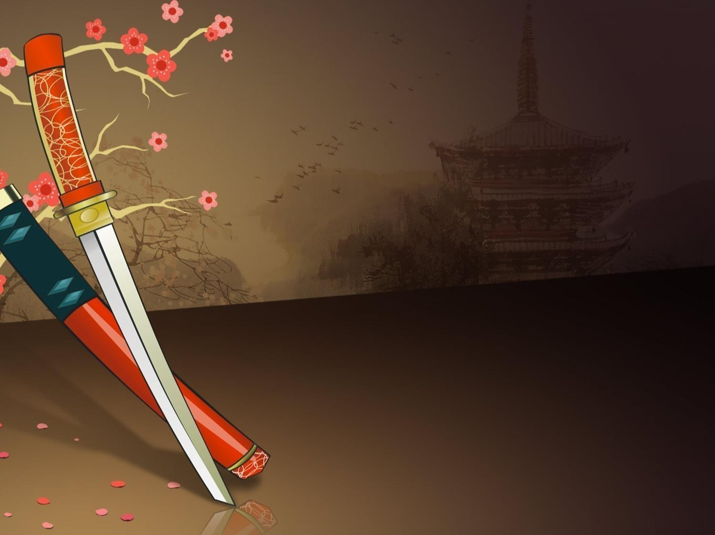
Japan samurais
(XII-XVII centuries)
clattered their guards
against sheath to attract
the rival’s attention

Slide 7
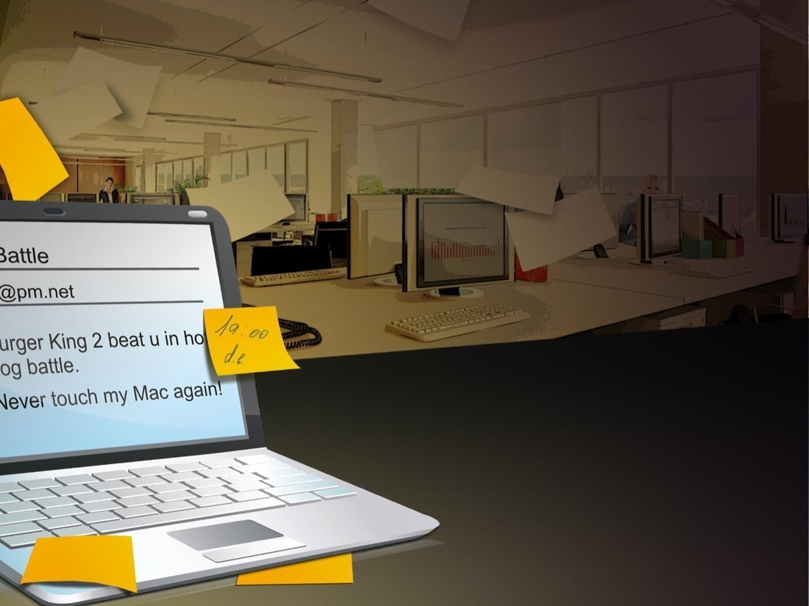
Office plankton
(XXI century)
send emails with
the Challenge subject
to their competitors

Slide 8
ONLYOFFICE stands for Peace
www.onlyoffice.com

